Slide 1
Sales Order and invoicing – desktop program
Jian Zhao
Dongfan Zhang

Slide 2
Background
From existing sales orders stored in database, enable user to issue the invoices for chosen sales orders.
Once invoice is issued, it will be stored into database, and corresponding order status will be changed to complete.

Slide 3
Solution overview
Functions to be implemented into program
Query Sales orders
Query Invoices
Issue invoices
export invoice to csv.
export invoice to PDF.
Export invoice and email as attachment

Slide 4
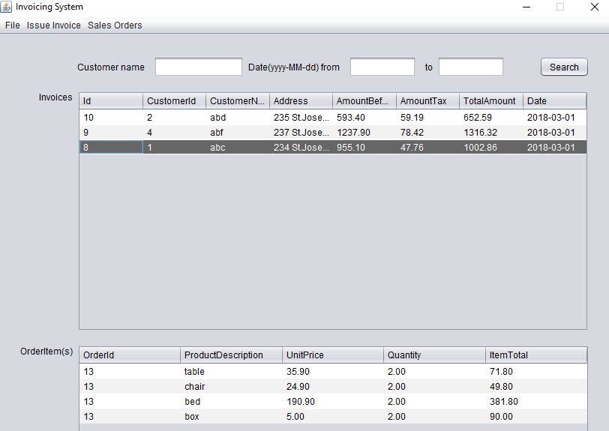
Invoice query

Slide 5
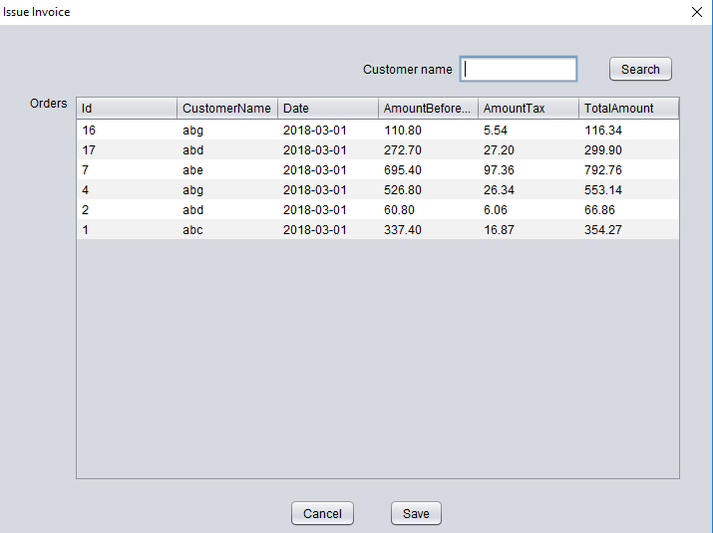
Issue invoices

Slide 6
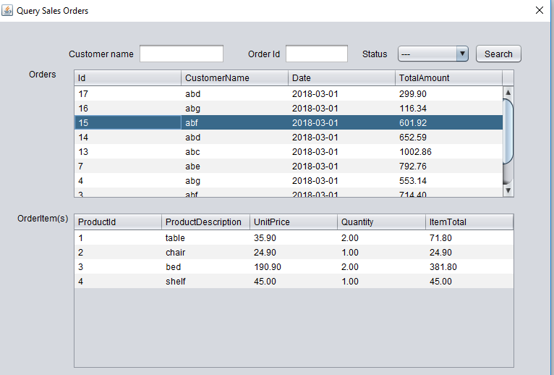
Sales orders query

Slide 7
Challenges and solution
Database design and data integrity (proper foreign key, constraint, and implement triggers)
Mapping the database tables to java entity classes (composition/ aggregation)
Write the DAO (database class)according to program requirements for the various data queries (overload method, StringBulider to write queries)
Manipulate data (work with Collections)
Find out how to export invoice as PDF (library)
Find out how to send emails via java (library)

Slide 8
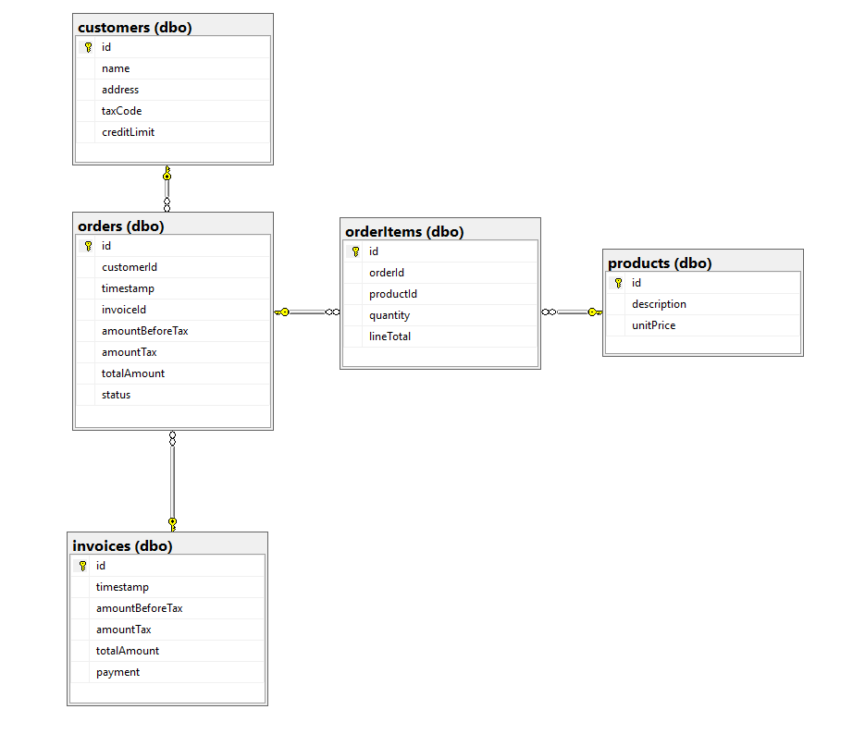
Database design – 5 tables

Slide 9
Every table in database is turned into one java entity class with their own attributes/ fields plus some composition/aggregation from other classes.
public class SalesOrder {
private int id;
private int customerId;
private java.sql.Date timestamp;
private BigDecimal amountBeforeTax;
private BigDecimal amountTax;
private BigDecimal totalAmount;
private OrderStatus status;
private List<OrderItem> items;
private Invoice invoice;
private Customer customer;
Public class Invoice {
Private int id;
private java.sql.Date timestamp;
private BigDecimal AmountBeforeTax;
private BigDecimal amountTax;
private BigDecimal totalAmount;
private BigDecimal payment;
private List <SalesOrder> salesOrder;
private Customer customer;

Slide 10
DAO (DATABASE class)
Using database connection transaction ensure the data integrity for issuing invoice (insert record into invoices table, meanwhile modify status to "complete" for orders through update orders table)
Overload getOrders method for adapting different search functionality
Using StringBulider instead of String for concatenation sql statements, which are easier readable and more elegant

Slide 11
Working with Collections
In our case, one invoice has one or several sales orders and one sales order can have multiple items. This often results to manipulate data collections.
Sample code as below:
List<Invoice> invoices = db.getInvoices(txtCustomerName.getText(), dateFrom, dateTo);
for (Invoice invoice : invoices) {
modelInvoices.addRow(new Object[]{
invoice.getId(),
invoice.getCustomer().getId(), invoice.getCustomer().getName(), invoice.getCustomer().getAddress(),
invoice.getAmountBeforeTax(), invoice.getAmountTax(), invoice.getTotalAmount(), df.format(invoice.getTimestamp())
});
}

Slide 12
Export to PDF
Using open source iText library for java
Using rectangle to implement block control for positioning paragraph text
Using table to display order items of invoices

Slide 13
Email with attachment using gmail
Using library activation.jar and javax.mail.jar, we can realise the function of sending email with attachment using Gmail server.
When user click export and send email. Program will first save csv to predefined folder then fetch the email address from database through customers table.
We write a separate email class with send method to wrap up all the code for email, in the main code class we just need to pass the arguments to the send method to realize the function

Slide 14
private void miExCSVEmailActionPerformed(java.awt.event.ActionEvent evt) {
exportCSV();
String email = ""; String fileName = "";
String filePath = new File("").getAbsolutePath() + "\\export_invoices\\csv\\";
final String user = "zdfmontreal13@gmail.com";
final String password = "zoe20178";
try {
Object invoiceId = modelInvoices.getValueAt(jtInvoices.getSelectedRow(), 0);
Invoice invoice = db.getInvoiceById(Integer.parseInt(invoiceId.toString()));
email = invoice.getCustomer().getEmail();
fileName = "invoice_" + invoice.getCustomer().getName() + "_" + invoiceId.toString() + ".csv";
} catch (SQLException ex) {
Logger.getLogger(MainFrameInvoice.class.getName()).log(Level.SEVERE, null, ex); }
System.out.println(email);
MailWithAttachment.send(user, password, email, "invoice", "please check invoice", filePath + fileName, fileName);
}

Slide 15
Future improvements
Add user log in interface when the program starts
Add different users roles like order entry, invoice issue, etc.
Add Sales orders management (create new order, update order, delete order)
Add payment function

Slide 16
Summary
By using various techniques, we successfully implemented planned functions for our Sales order invoicing mini program

